Slide 1
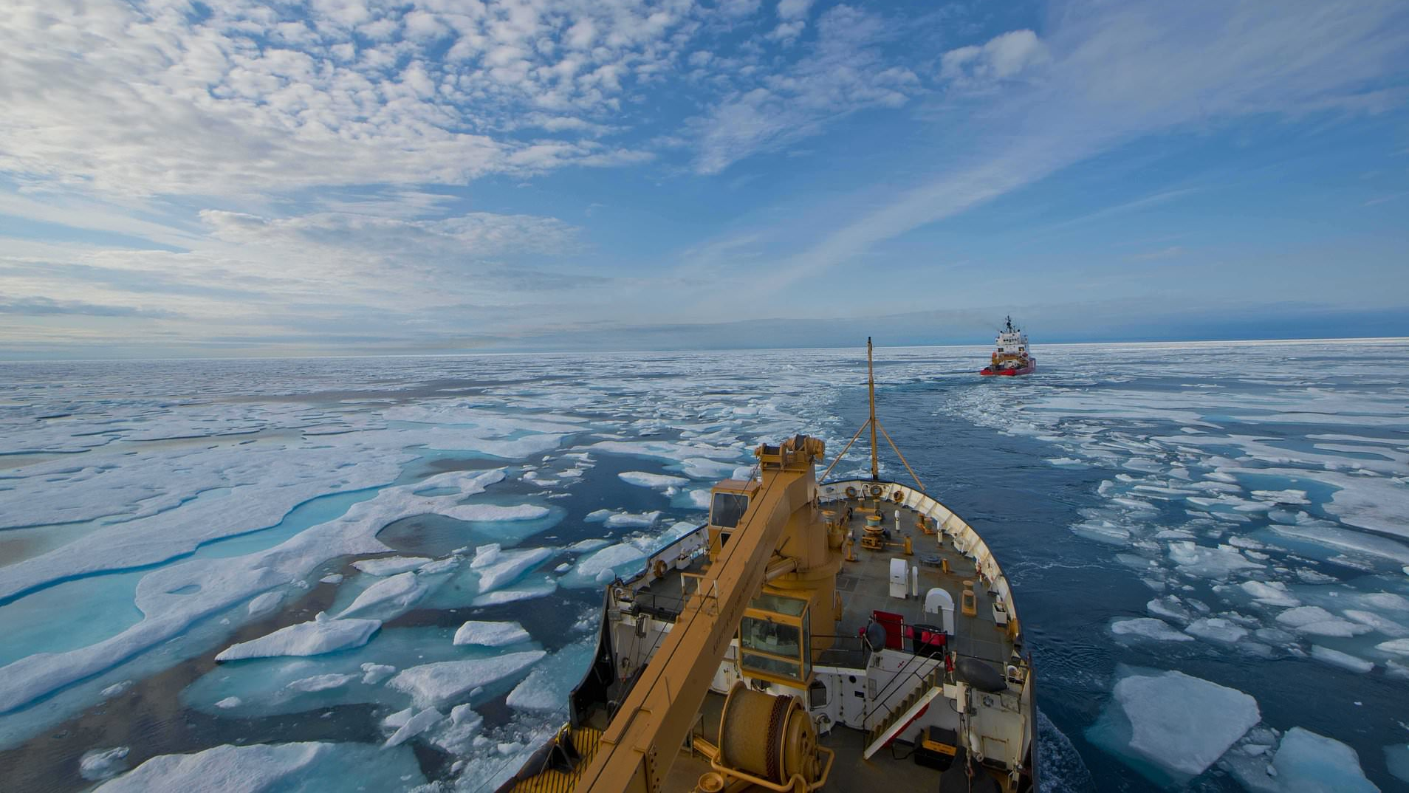
A New Ocean
The Battle for the Arctic
Mead Treadwell
Co-Chair, The Wilson Center Polar Institute
Lieutenant Governor of Alaska (2010-14)
Chair, US Arctic Research Commision (2006-2010)
Chair/CEO Qilak LNG
Vice Chair, Alaska, A2A Rail
Chair, Iridium Polar Advisory Board
Presentation for Indiana Council on World Affairs, Great Decisions Program, March 2, 2021

Slide 2
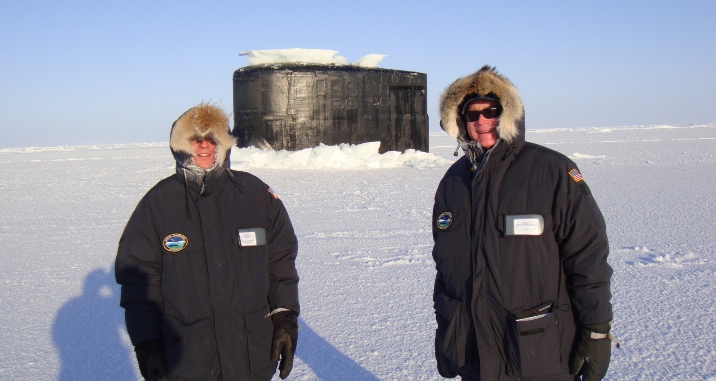
The Arctic in the 21st Century | The Wilson Center Polar Institute
Rear Admiral David Titley (Oceanographer of the USN) with Lieutenant Governor Mead Treadwell (Alaska) beside the USS Connecticut (SSN-22), 200 miles north of Alaska during SCICEX in March 2011.

Slide 3





Slide 5

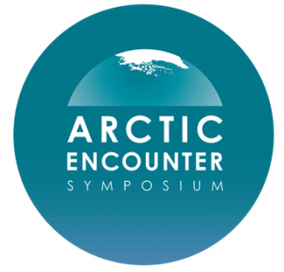




Arctic Thought Leader Partners

Slide 6
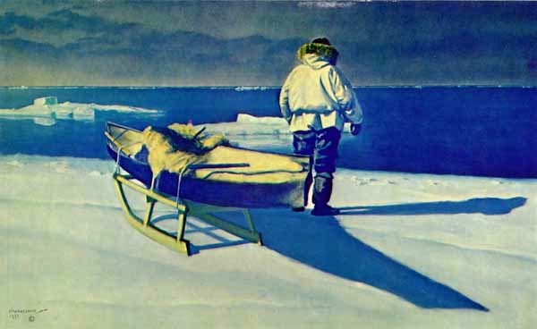
The Arctic in the 21st Century | The Wilson Center Polar Institute
“[It] doth suffer a sea-change,
into something rich and strange.”
—Shakespeare, The Tempest

Slide 7
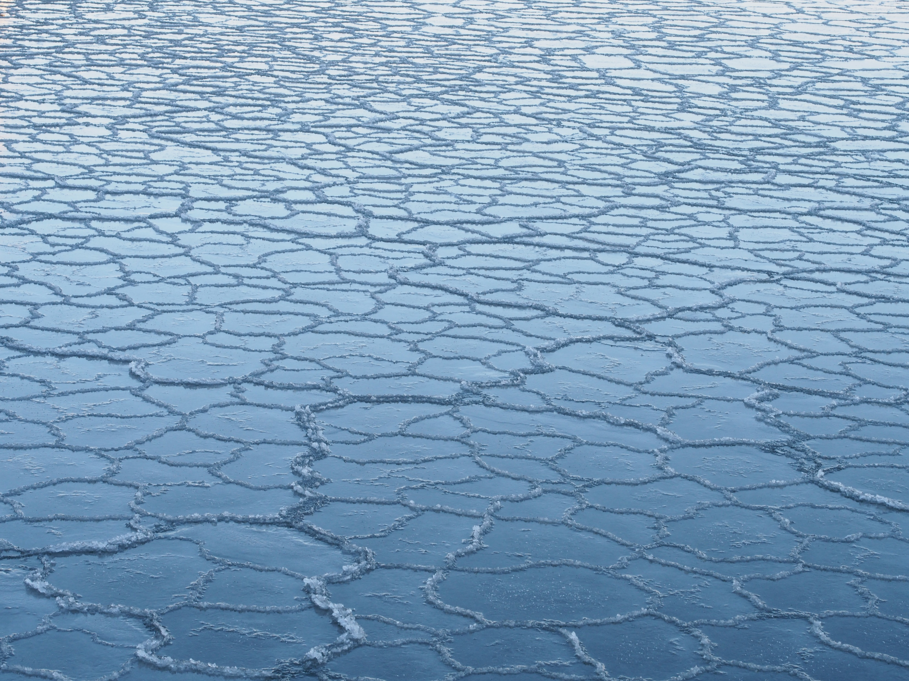
Today’s talk: Great Decisions in the Arctic
Arctic Realities
Governance so far:
  Law of the Sea
  Arctic Council Accomplishments
  Recent Statements by the New Administration
Concerns
  Security and Great Power
  Climate Understanding
  Infrastructure and Investment
Conclusions and Policies Ahead
  How do climate concerns affect investment?
  How do security and trade concerns affect investment?
  Arctic “presence” of the United States

Slide 8
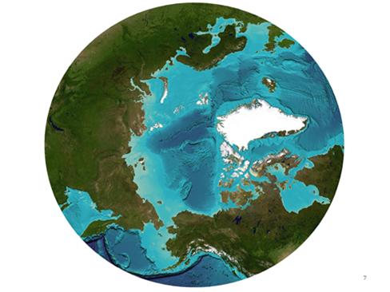
The Arctic…
Feeds the world
Fuels the world
Provisions the world
Protects the world
Connects the world
Inspires the world

Slide 9
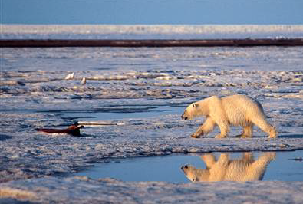

Slide 10
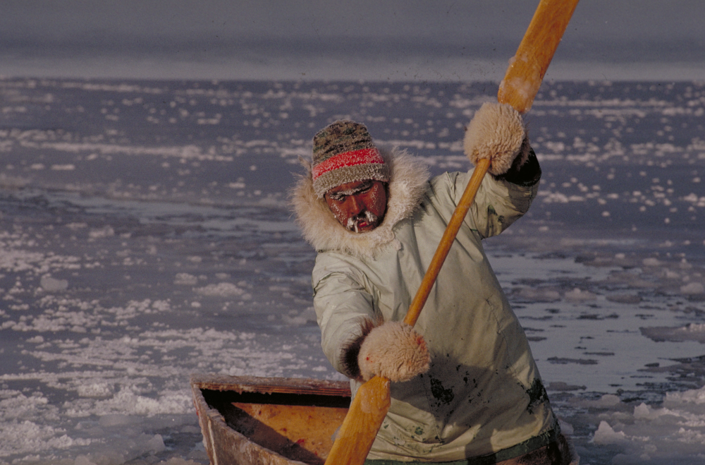
Notes:
10

Slide 11
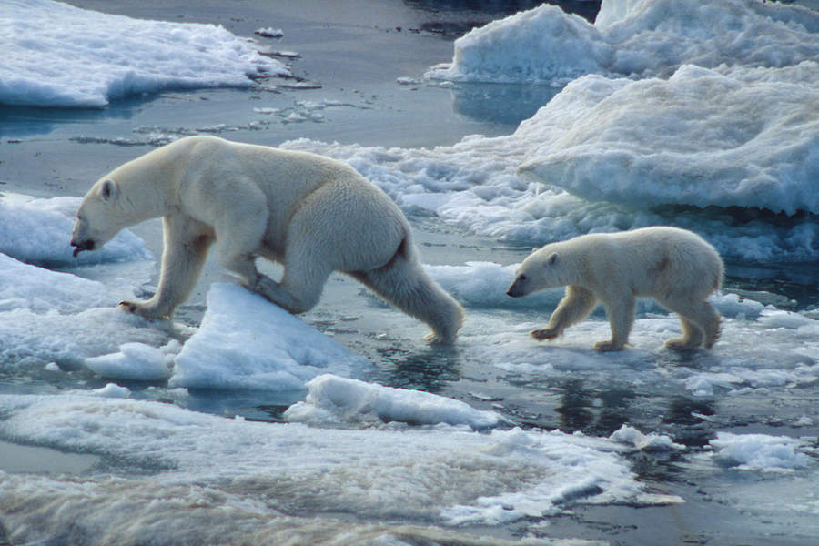
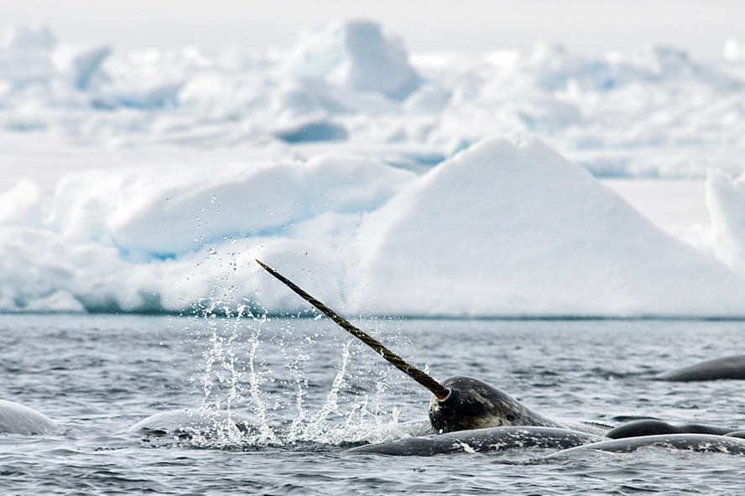
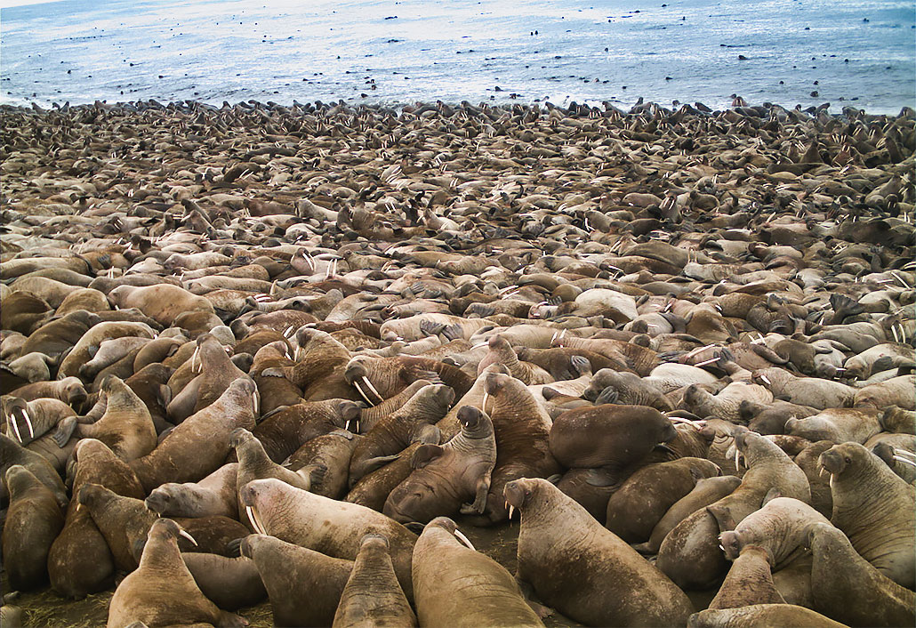
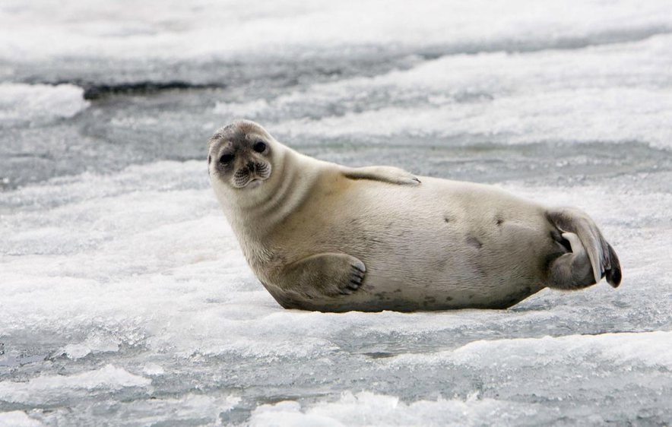
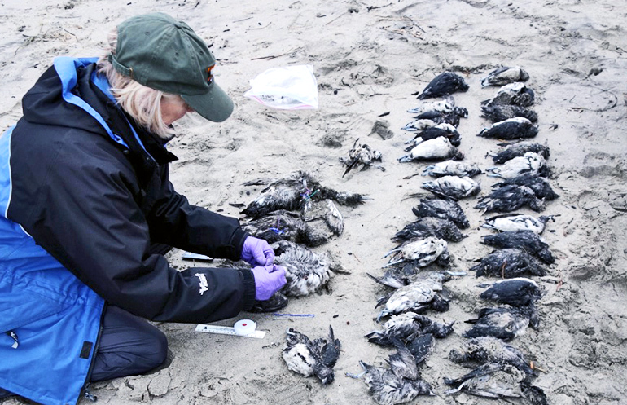
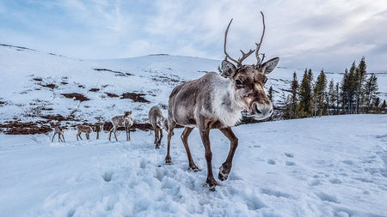
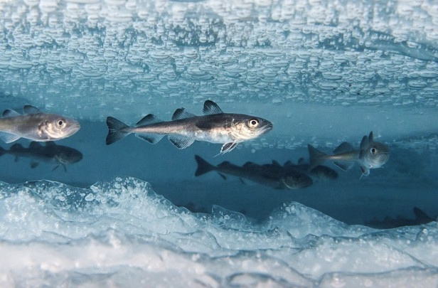
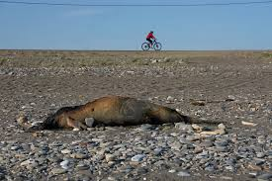
The Arctic in the 21st Century | The Wilson Center Polar Institute

Slide 12
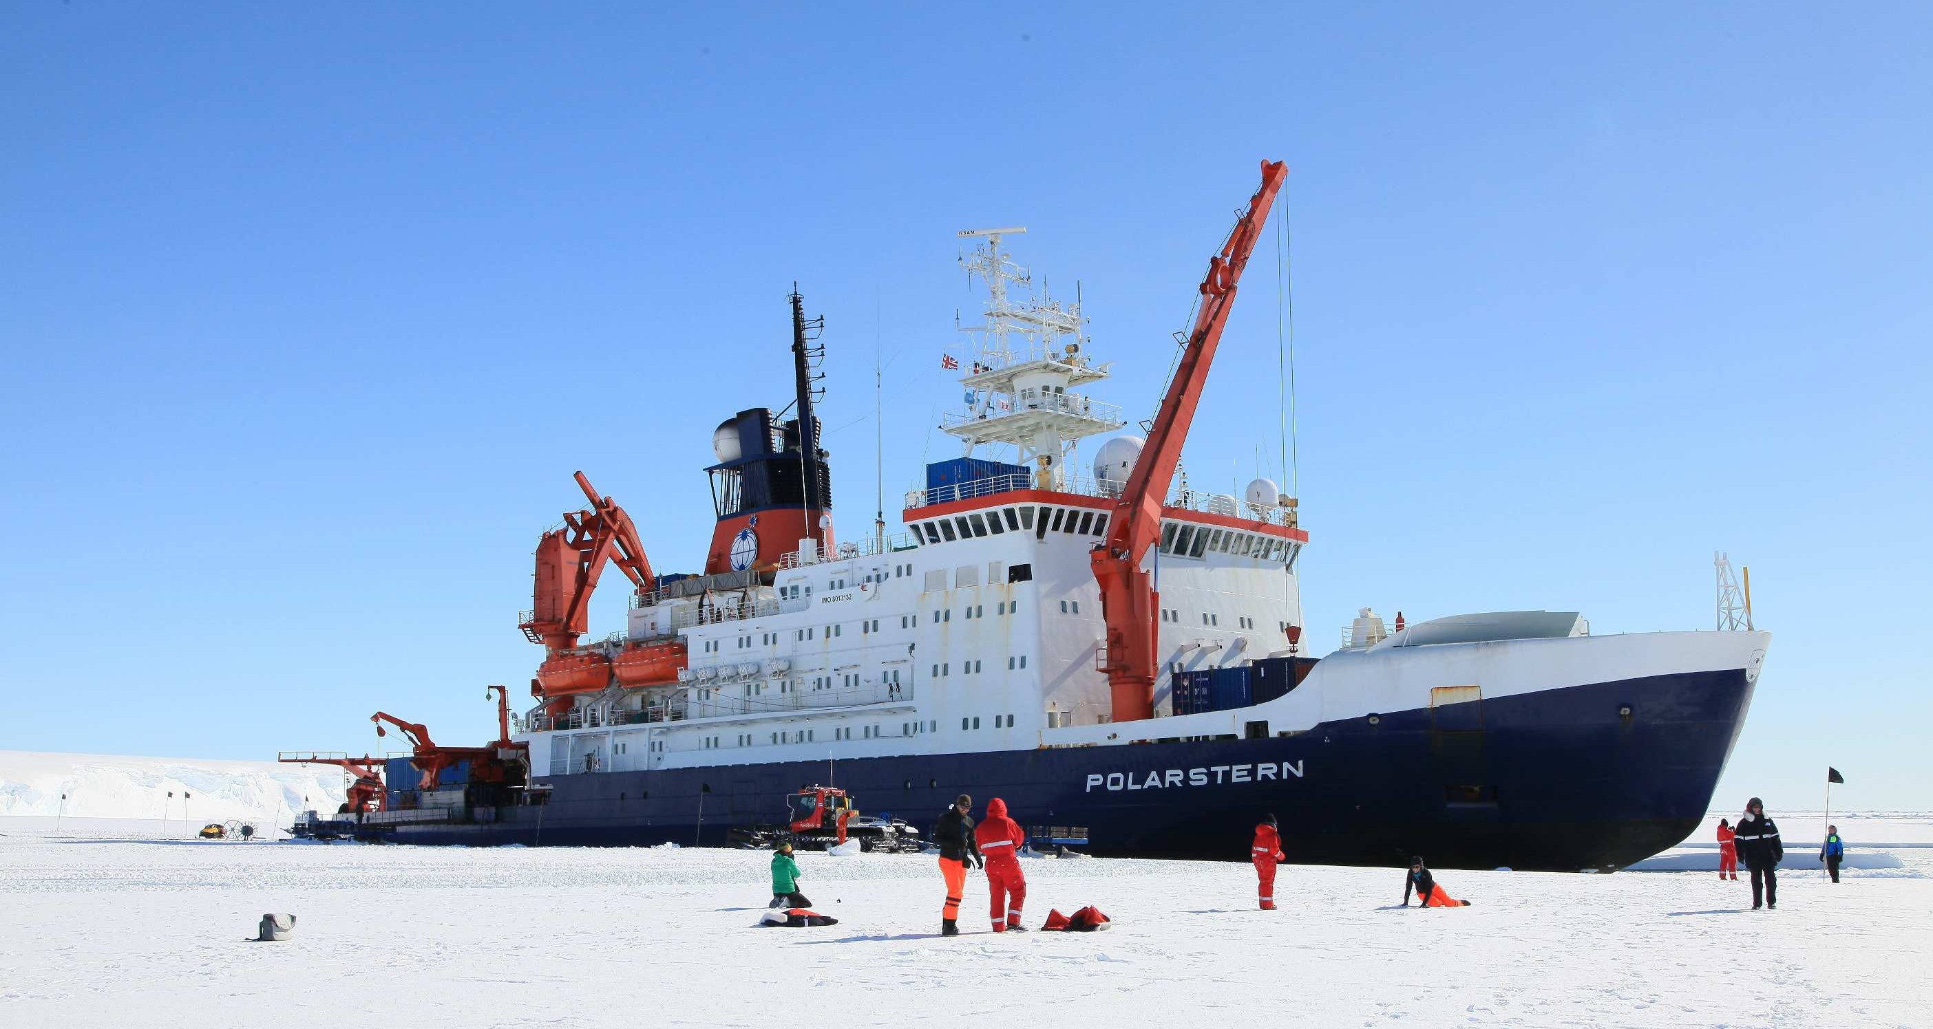
The Arctic in the 21st Century | The Wilson Center Polar Institute
Notes:
The MOSAIC Expedition: "Multidisciplinary drifting Observatory for the Study of Arctic Climate"
Launched in September 2019
Polarstern – research icebreaker from Germany's Alfred Wegener Insitute
Will involve more than 600 people from 60 institutions, 19 different countries
Russian, Chinese icebreakers involved in support operations
Will freeze themselves into the ice and drift towards the North Pole over the winter (a la Nansen's journey in the Fram)
Claims to represent the "largest Arctic expedition in history"

Slide 13
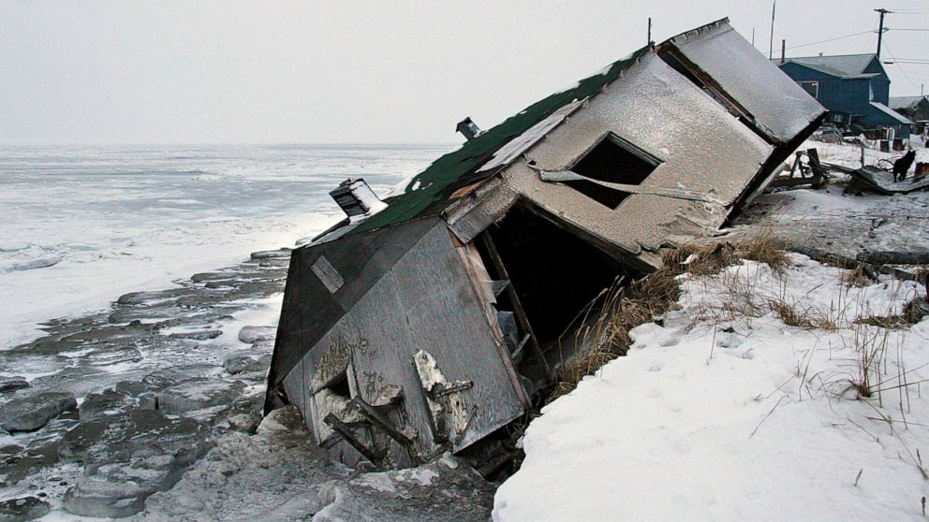
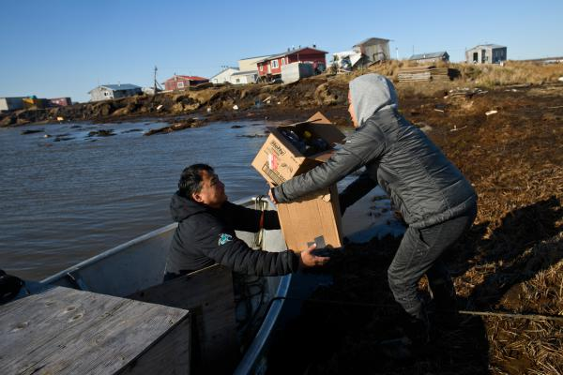
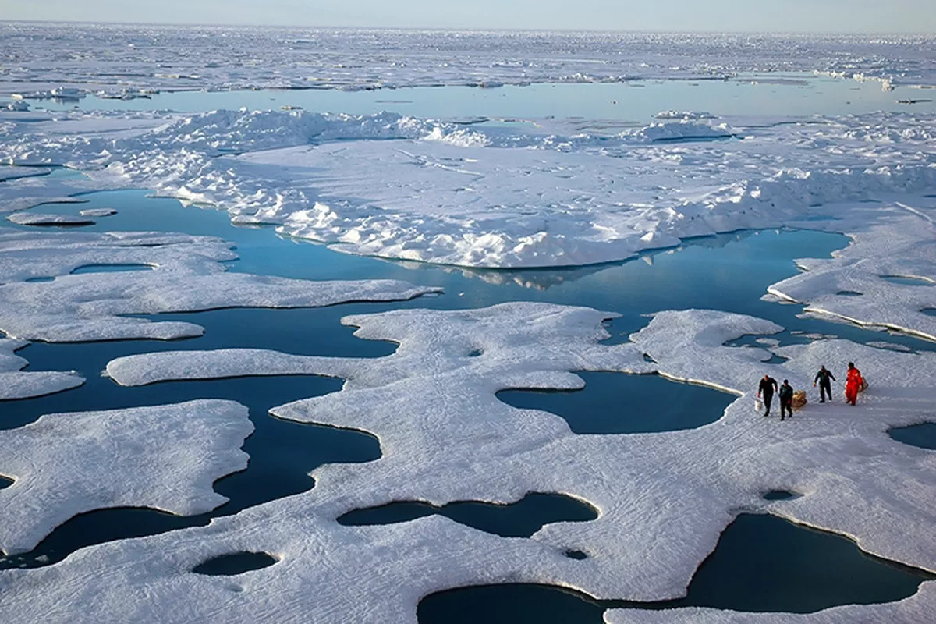
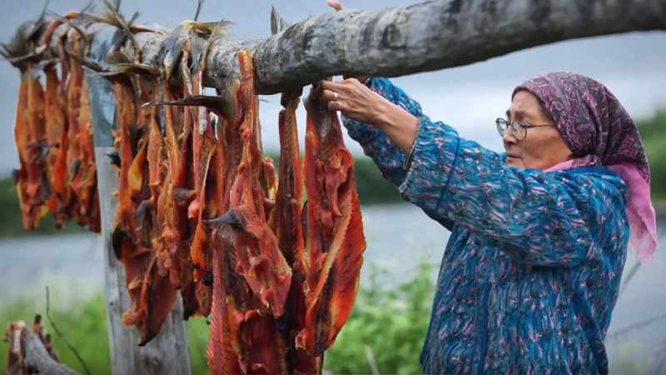
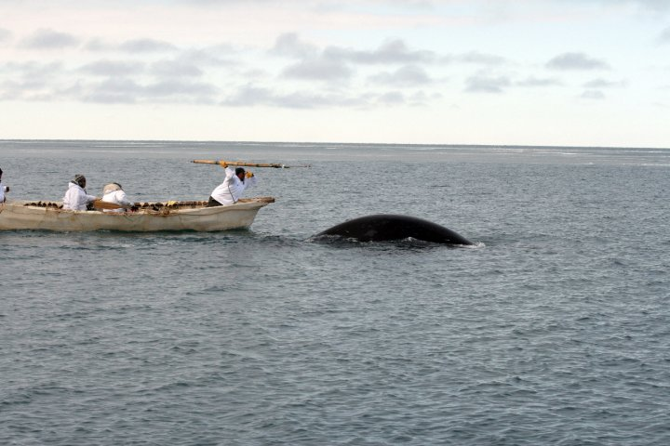
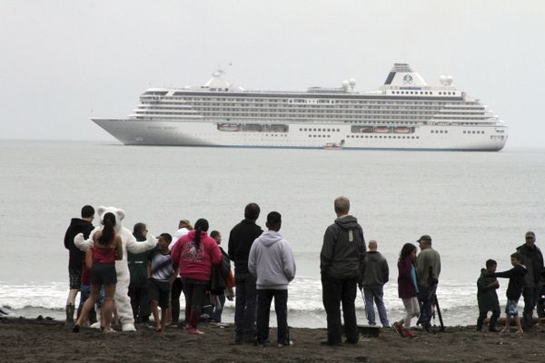
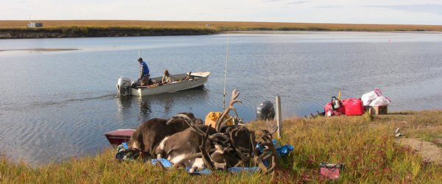
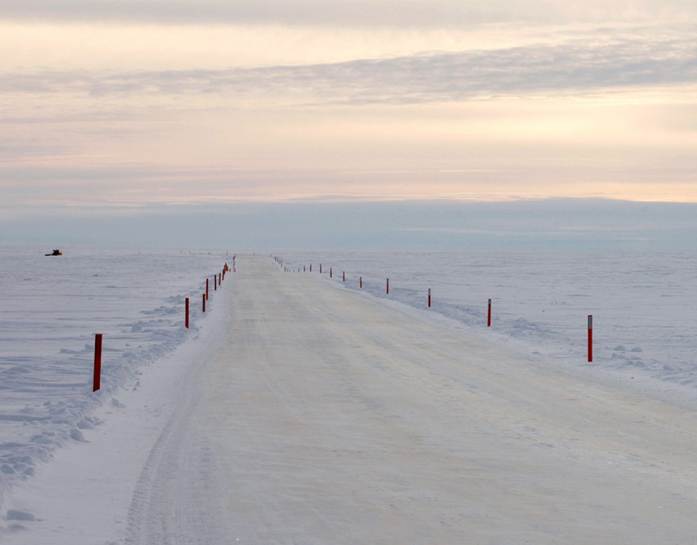
The Arctic in the 21st Century | The Wilson Center Polar Institute

Slide 14
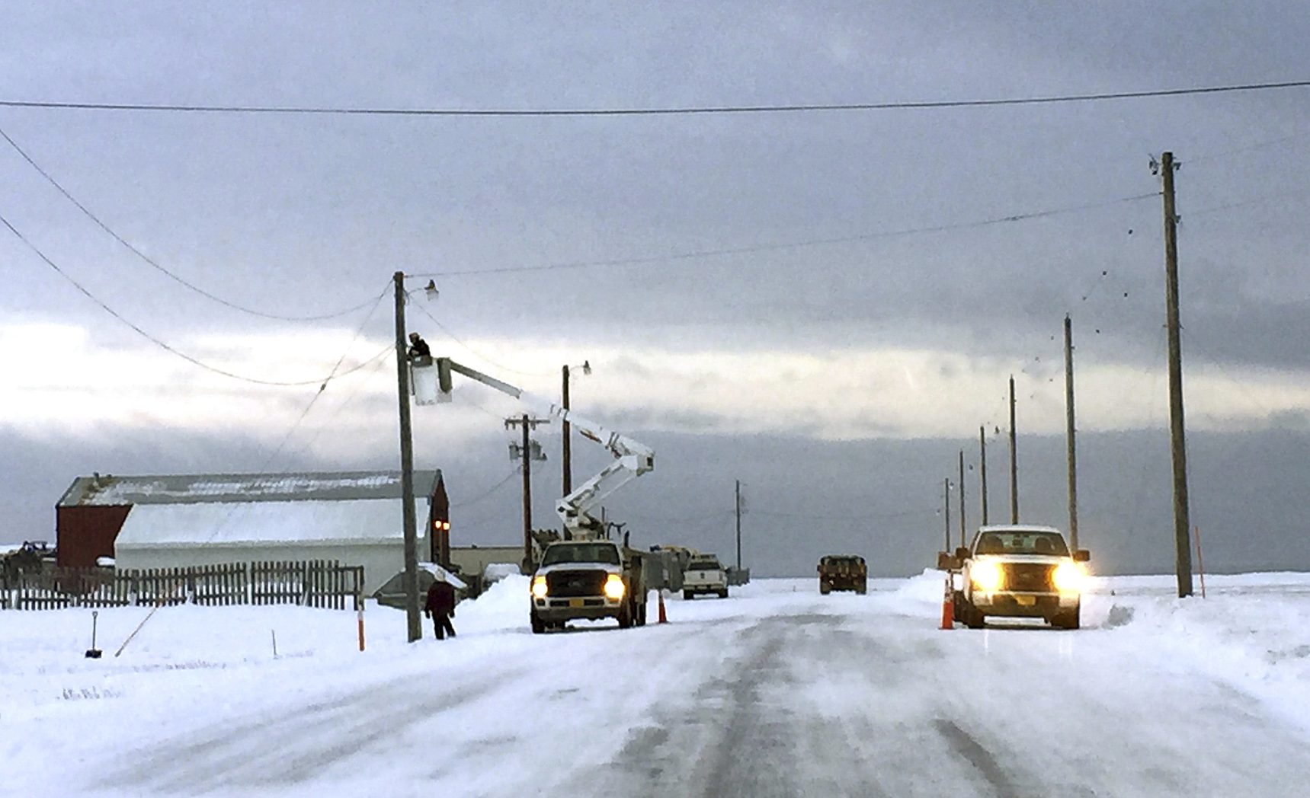
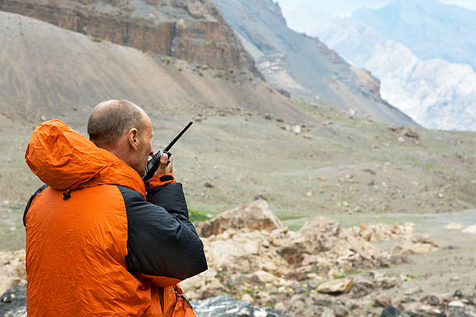
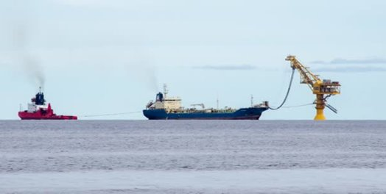
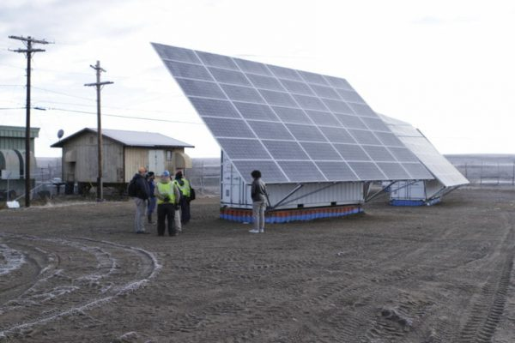
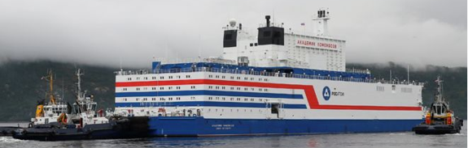
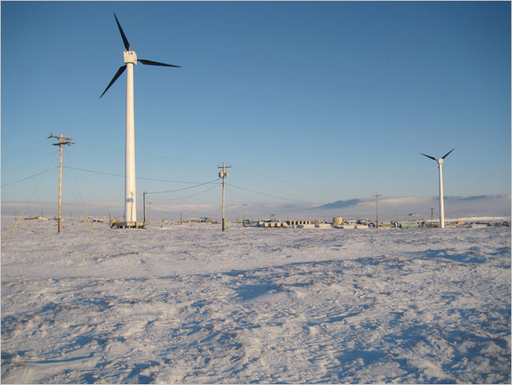
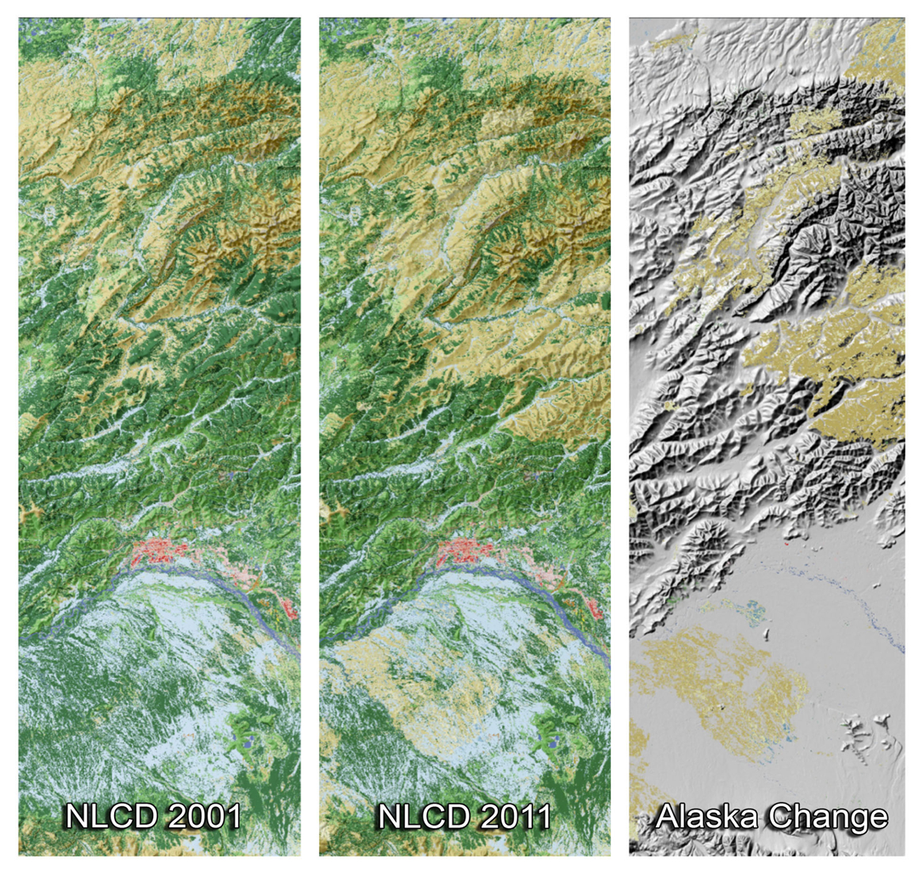
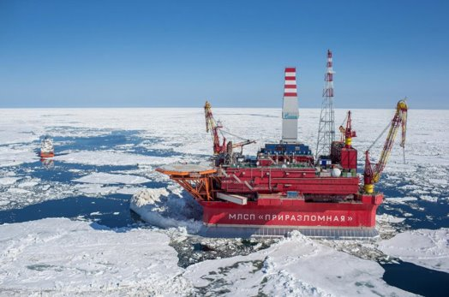
The Arctic in the 21st Century | The Wilson Center Polar Institute
Notes:
Broadband installation in Point Hope; Wind turbines in Toksook Bay; Stock image of a satellite phone in the Brooks Range; Solar panels in Buckland; etc

Slide 15
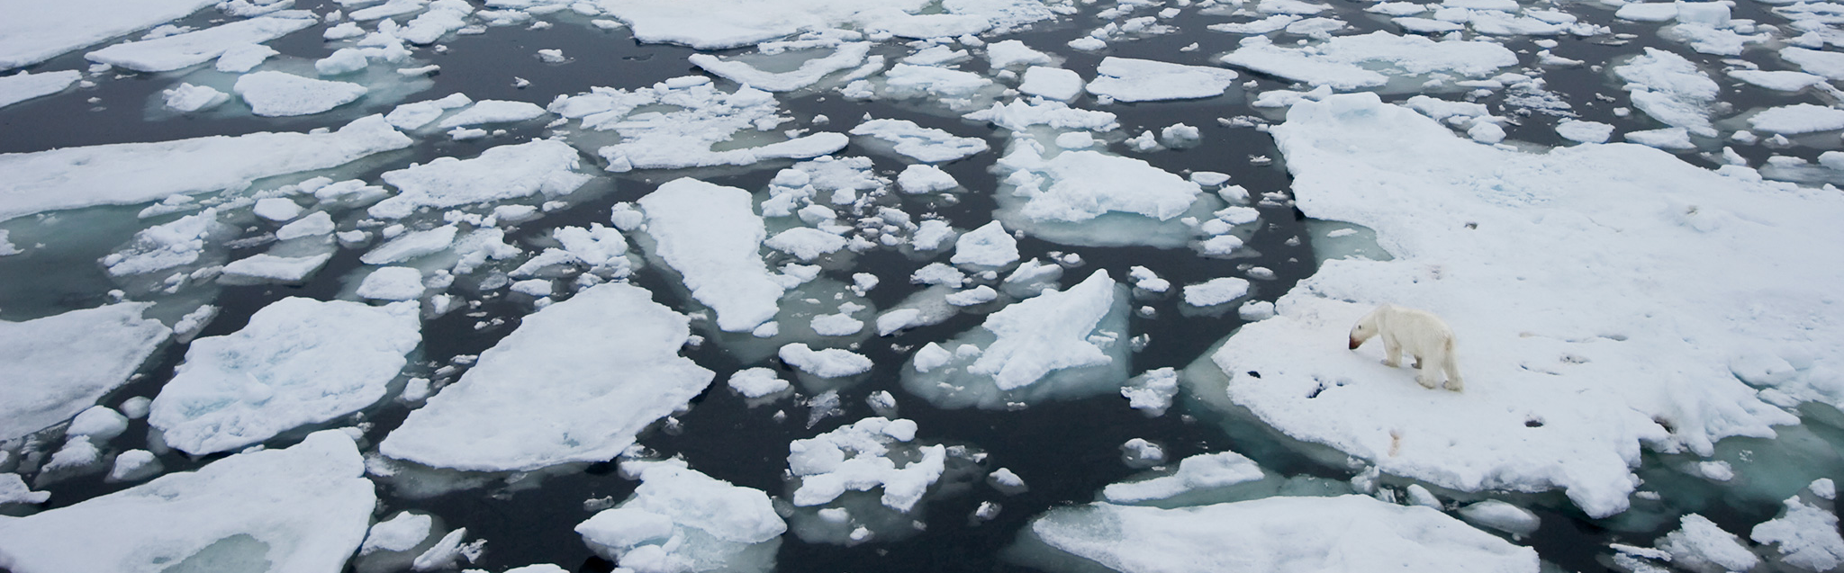
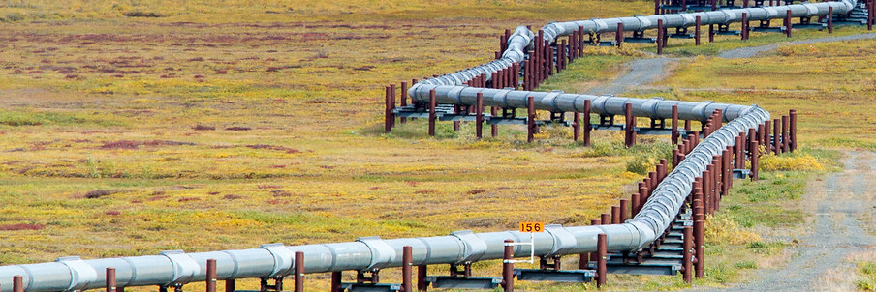
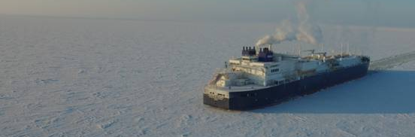
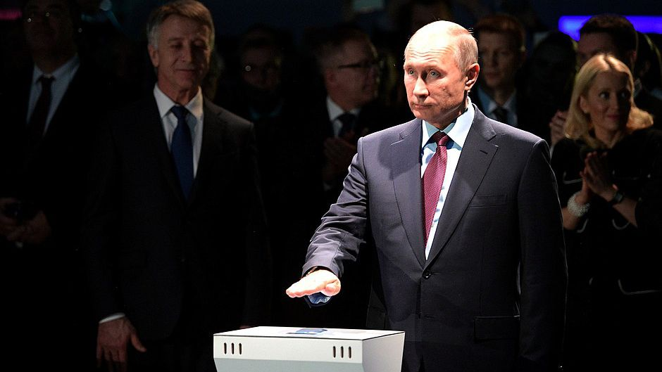
Climate Change
What’s driving
change,
cooperation,
conflict…. in the Arctic today?
Global Resource Demand
Technological Innovations
Major Power Competition

Slide 16
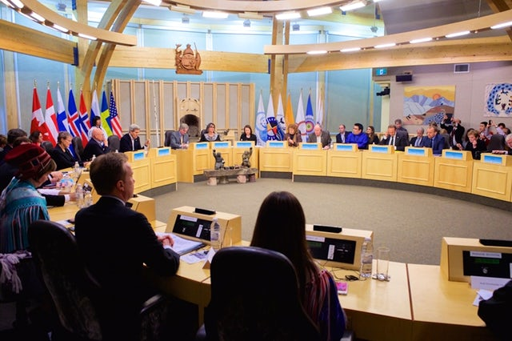

Governance
The Arctic Council
Established in 1996
Members
  Eight Arctic Nations
  Permanent Participants
  Observer States and NGOs
Working Groups
  Arctic Contaminants Action Program (ACAP)
  Arctic Monitoring and Assessment Program (AMAP)
  Conservation of Arctic Flora and Fauna (CAFF)
  Emergency Prevention, Preparedness, and Response (EPPR)
  Protection of the Arctic Marine Environment (PAME)
  Sustainable Development Working Group (SDWG)
Barred by mutual agreement from discussing military security
The Arctic in the 21st Century | The Wilson Center Polar Institute

Slide 17
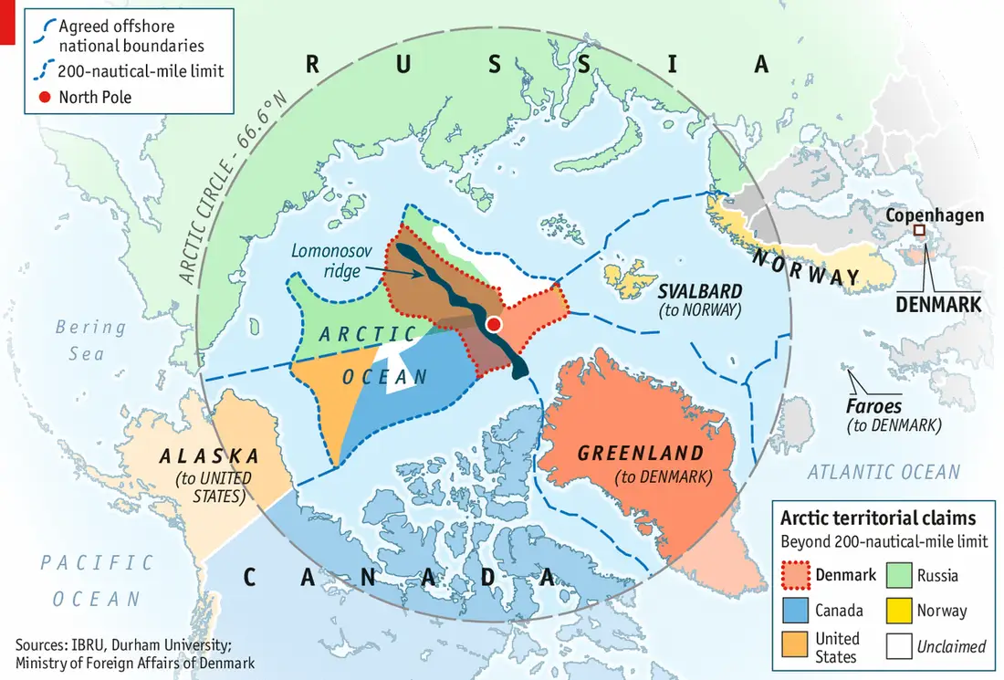
The Arctic in the 21st Century | The Wilson Center Polar Institute
Source: The Economist

Slide 18
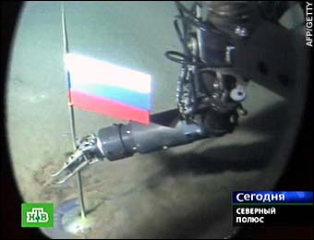
Notes:
So my first point: why the Arctic matters.
▪ This is the third great ocean… An emerging market… The opportunity of a generation.
▪ We need to go to the Arctic with purpose. Like Kennedy to the moon, Eisenhower to the Interstate Hwy system, Teddy Roosevelt to the Panama Canal --- we should expect strong leadership from our president. Putin is saying it… Harper and Grimsson are saying it… Even China, Singapore and Japan have a vision. Why is America so far behind?

Slide 19
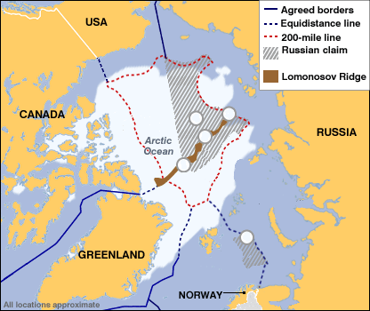
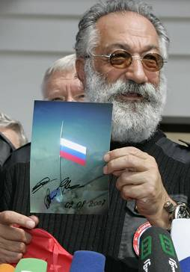
Sovereign Rights and Jurisdiction
4
3
2
1
5
North Pole 3) 200 nautical mile line 5) EEZ & CS Dispute
2) Lomonosov Ridge 4) Russian-claimed ECS
Notes:
Current Legal Situation:
No treaty was drawn due to previous inaccessibility, potential for treaty of neutrality similar to Antarctic
Disposition of claims and counterclaims are resolved by international committees
International seabed authority
International Tribunal for the Law of the Sea
These groups lack the authority to settle contested claims when all parties are unable to agree
Other bordering nations are moving to establish their claims within the 10 year time limit under the UNCLOS
The current administration has endorsed ratification of the treaty by the US Senate
Rejected by the Reagan administration, and signed during the Clinton administration
Ratification of the treaty has been unsuccessful due to unresolved concerns over sovereignty related issues
North Pole, Lomonosov Ridge
Areas claimed by Russian government: large area in dispute with Canada, Denmark; small area in dispute with Norway
Internal Waters…coastal state is free to set laws, regulate any use, foreign vessels and aircraft have no right of passage
Territorial Waters (12 nm from Shore)…coastal state is free to set laws, regulate any use
Contiguous Zone from (12 nm – 24 nm)…limited power to regulate, freedom of navigation and overflight
Exclusive Economic Zone (EEZ) (out to 200 nm)…sole exploitation rights over all natural resources, freedom of navigation and overflight (Art. 58)
Continental Shelf (out to max of 350 nm)…sole rights to mineral and other resources of the seabed, freedom of navigation and overflight (Art. 78)
Territorial Sea…“Innocent Passage” but no overflight
==========================================================================================================
Bordering Nations Activities:
Russia
Planted Russian flag at seabed location of North Pole on 3 AUG 07
AUG 07 expedition to gather data for continental shelf claim along the Lomonosov Ridge NLT 2009
Canada
2006 campaign promise by PM Stephen Harper to protect Canadian sovereignty
Proposal to build 8 ice reinforced patrol ships and develop 2 ports for support
Expedition to map undersea floor to establish continental shelf limits to support claim NLT 2013
Denmark
2007 expedition to map undersea floor to establish continental shelf limits to support claim NLT 2014
United States
Recent USCG mission, mapping of sea floor north of Alaska
Potential USCG base in Barrow, Alaska

Slide 20
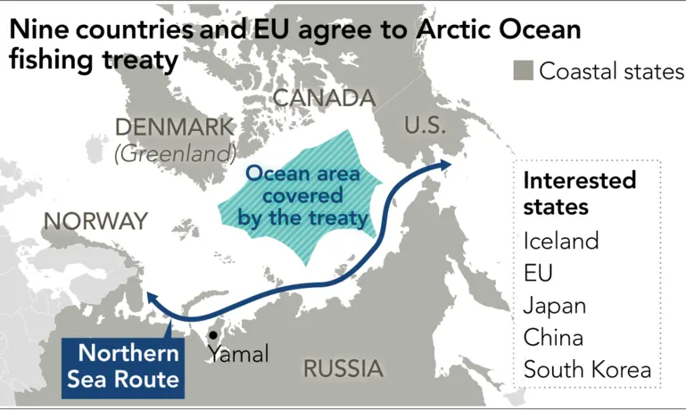
The Arctic in the 21st Century | The Wilson Center Polar Institute
Source: Nikkei Asian Review
Notes:
Signed October 2018
Signatories include the Arctic Coastal States (US, Russia, Norway, Iceland, Canada, Denmark) + Japan, China, and South Korea
About the Agreement:
The Agreement bars unregulated fishing in the high seas of the central Arctic Ocean for 16 years and establishes a joint program of scientific research and monitoring to gain a better understanding of Arctic Ocean ecosystems.
It also authorizes vessels to conduct commercial fishing in the CAO only after international mechanisms are in place to manage any such fishing.
It marks the first time an international agreement of such magnitude has been proactively reached before any commercial fishing has taken place in a high seas area.

Slide 21
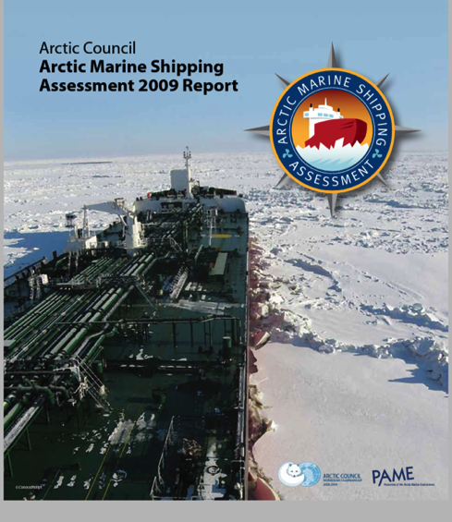
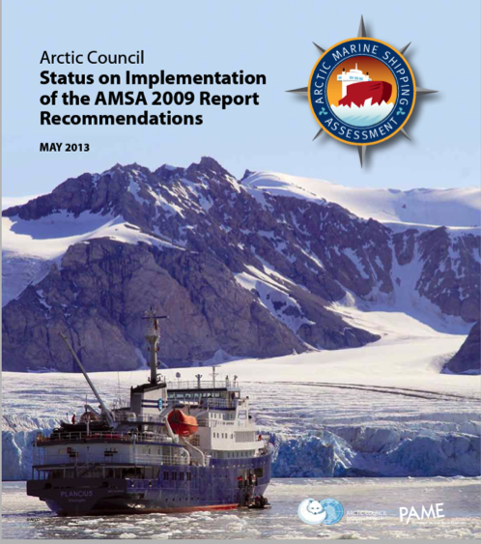
Eight Nations Set a Safety Agenda in 2009

Slide 22
Arctic Shipping Rules Take Shape
Article 234 Law of the Sea
Russian, Canadian, U.S. legislation
National policies (Council and Observers)
Arctic Marine Shipping Assessment 2009
Arctic Council SAR Agreement 2011
Arctic Council Oil Spill Agreement 2013
IMO Polar Code (2014) effective 2017
Current Arctic Council work by PAME
Coast Guard Forum

Slide 23
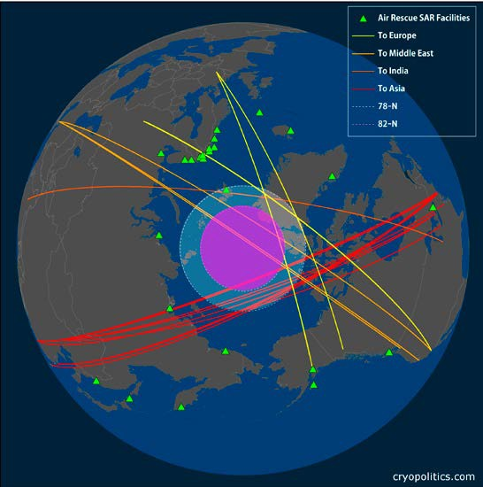
Trans-polar airline routes and locations of rescue coordination centers around the Arctic.
Mia Bennett / cryopolitics.com

Slide 24
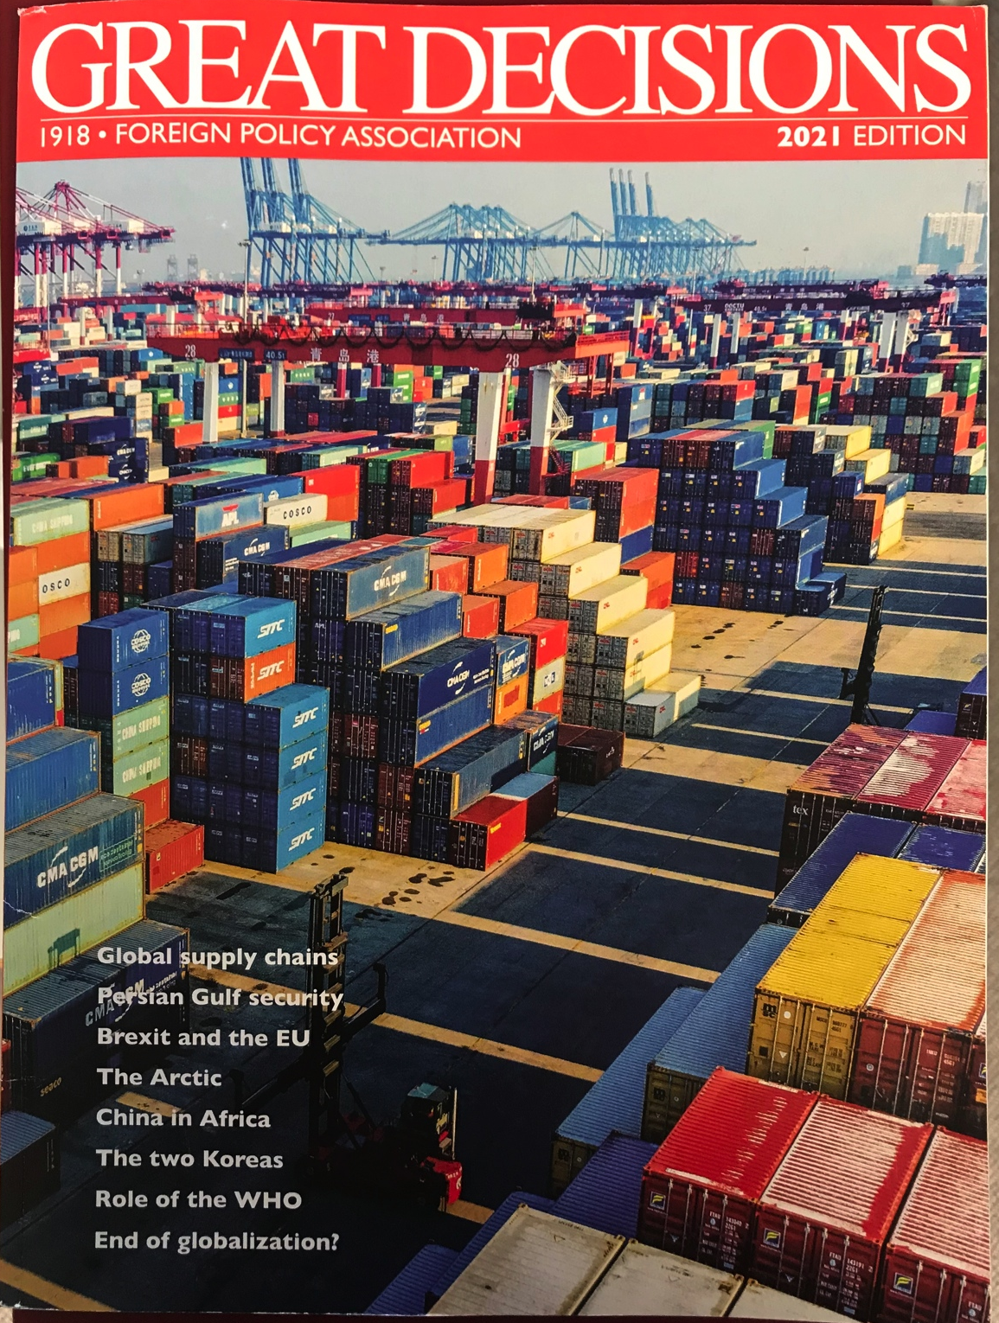
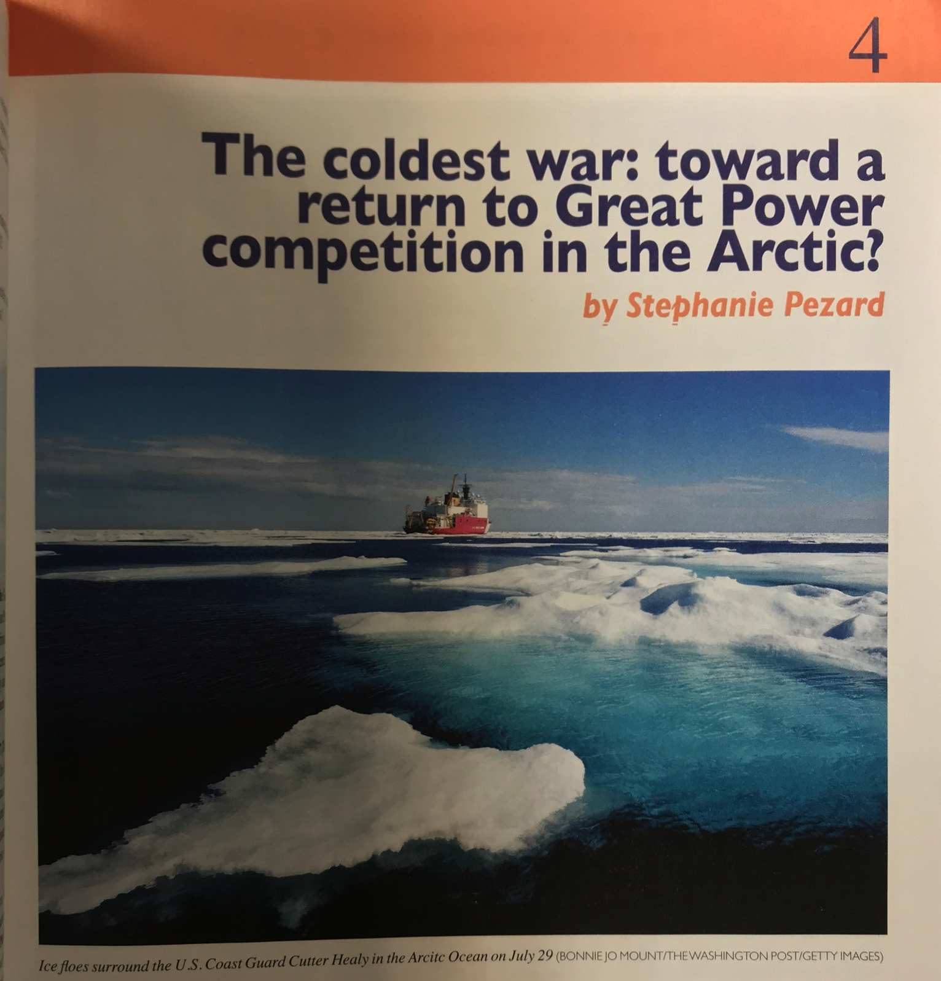

Slide 25
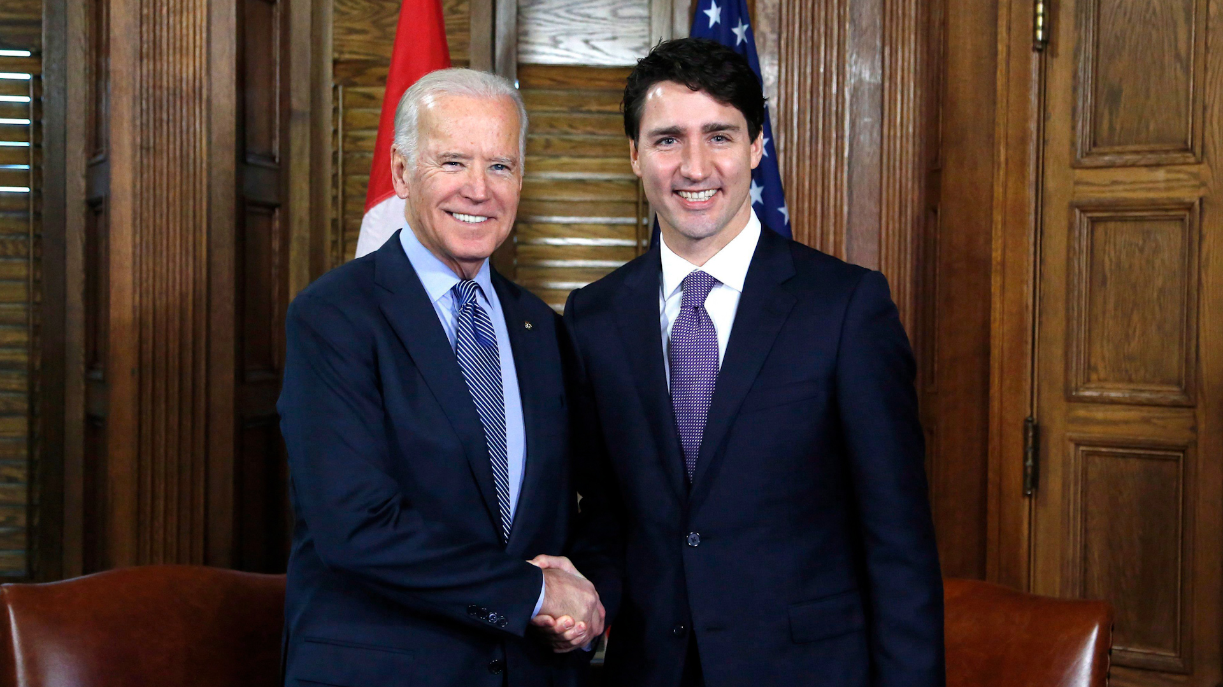
Biden-Trudeau Statement
On Feb 23rd 2021, President Joe Biden and Prime Minister Justin Trudeau held their first bilateral meeting together.
Joe Biden:
“We will launch an expanded U.S-Canadian Arctic dialogue to cover issues related to continental security, economic and social development, and Arctic governance.
“Canadians and Americans are innovative, creative, open-hearted, and rights-respecting. There’s nothing we cannot achieve when we commit ourselves to it. And when we work together, as the closest of friends should, we only make each other stronger.”
Justin Trudeau:
“The President and I discussed the ambitious new partnership roadmap, based on shared values and priorities, that will guide our countries work together over the coming years.”

Slide 26
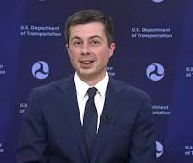

U.S Dept. of Transportation and Transport Canada, February 25, 2021
“We are dedicated to working with the International Maritime Organization to effectively implement the ban on the use and carriage of heavy fuel oil as fuel in the Arctic. We also look forward to exploring how we might address and support the transportation infrastructure needs of the Arctic and Northern communities, such as safety, climate change, and fostering socio-economic opportunities.”
Pete Buttigeig
U.S Secretary of Transportation
Omar Alghabra
Canada Minister of Transport

Slide 27

Jennifer Granholm, U.S Secretary of Energy,
January 21, 2021 hearing before U.S Senate Committee on Energy and Natural Resources
“I believe U.S LNG export can have an important role to play in reducing international consumption of fuels that have greater contribution to greenhouse gas emissions. I look forward to working with U.S industry in ways to reduce emissions associated with this commodity…”

Slide 28




Quad Nations and the Arctic?
The Quadrilateral Security Dialogue Est.2007
U.S.A
India
Japan
Australia

Slide 29

Security
Does the “New Ocean” destabilize the cooperative geopolitical framework that developed in the post-Cold War period?
Is there a power imbalance in the Arctic? If so, does it affect regional stability?
Can the Arctic remain “de-linked” from disputes between the Arctic nations (e.g. Russia and the US) elsewhere around the globe?
The Arctic in the 21st Century | The Wilson Center Polar Institute

Slide 30



Russia’s Arctic Strategy: Territorial Defense or Militarization?
The Arctic in the 21st Century | The Wilson Center Polar Institute

Slide 31
The Arctic in the 21st Century | The Wilson Center Polar Institute
Notes:
First proposed in 2005
Russian government chose Novatek's Yamal proposal as a test pilot in 2010
Groundbreaking ceremony: July 2012
Actual construction began: 2013
Commercial operation and first carrier loading: December 2017
Total project cost: $27 billion (estimated)

Slide 32



LNG Shipping Solution
Vessel going stern first in heavy ice
Vessel going bow first in open water
Notes:
Yamal Carriers: 299m long x 50m wide, 172,800m3, 45MW
Melville Island Carriers: 335m long x 43m wide, 140,000m3, 134MW

Slide 33

The Arctic in the 21st Century | The Wilson Center Polar Institute
Summer 2019

Slide 34


YamalMax Arctic LNG Carriers
Rated to Arc7
  Icebreaking capacity (astern): 2.1 m
Double-Acting Ship (DAS) concept
Example of globalization in the Arctic
  Designed in Finland
  Built in South Korea
  Operating in Russia
15 built since the launch of the Christophe de Margerie in 2016
The Arctic in the 21st Century | The Wilson Center Polar Institute

Slide 35


Russia, Arctic LNG 2 Project
Project status
Front-end engineering design (FEED) was completed in October 2018
Final investment decision made in September 2019
EPC-contract with TechnipFMC was signed
More than 90% of equipment for the project contracted
Russian government will cover 60% of the shipping terminal cost of $2.17 bn
Notes:
(Barents Observer; Norway; April 16) - The Russian government this week approved further financial participation as costs have risen for a natural gas project on the coast of far northern Gydan Peninsula. The government assistance, lobbied by project operator Novatek, will cover 60% of the shipping terminal’s total cost of 164.1 billion rubles ($US2.17 billion), which is up 14% from the original estimate.

Slide 36

The Arctic’s Resource Potential
The Arctic in the 21st Century | The Wilson Center Polar Institute

Slide 37

Financial autonomy: a widely-held goal in Greenland
Experience of Alaska, Norway, Western U.S. States and Canadian Provinces / Territories can assist Greenland in making a plan
Assets owned/controlled by home rule government can be sold, leveraged, or developed to expand government/common income
Alaska Mental Health, School Trusts, Permanent Fund, Community Development Fishing Quotas, Tourism taxes are illustrative
Targeted investments in infrastructure (e.g. radar for overflight income) can also expand income
Notes:
Co-investments = Based on GP approval?

Slide 38

The Arctic in the 21st Century | The Wilson Center Polar Institute
Notes:
Video of the Arctic

Slide 39

Why should you care?
Jet stream position is affected by sea ice cover.

Slide 40

The Infrastructure Gap
Russia
United States
Canada
Norway
Sweden
Iceland
Finland
Greenland
The Arctic in the 21st Century | The Wilson Center Polar Institute

Slide 41


The Simple Math Problem
Distance: Hamburg to Yokohama
(nautical miles)
Northern Sea Route ~ 6,920 nm
Suez Canal ~ 11,073 nm
Panama Canal ~ 12,420 nm
Cape of Good Hope ~ 14,542 nm

Slide 42


Opening Seaways

Slide 43

A Business Plan for a New Ocean

Slide 44



The SEAL Act: "Uber for Icebreakers”
Safety: Safe shipping in the Arctic requires maritime transportation infrastructure, including ports of refuge, mapping and charting, ice reporting and forecasting, and icebreakers to assist when ice conditions require.
Security: An international presence in serving Arctic shipping, with full respect for and potential cooperation with the system Russia has in place, will attract greater usage of Arctic routes.
Reliability: More resources means a dependable ocean, and dependable shipping.
The Arctic in the 21st Century | The Wilson Center Polar Institute

Slide 45

USGC – New Heavy Polar Security Cutters
Contract awarded to Halter Marine of Pascagoula, Miss. for $746M for non-recurring engineering, detailed design and construction of the 1st vessel ($675M) plus long leads items for the 2nd.
Delivery of 1st cutter expected in 2024, with 2nd and 3rd cutters in 2025 and 2026
The cutters will replace the 40+ year old Polar Star and the Polar Sea (laid up since 2010 with engine failure)
First two vessels may be required to support McMurdo base in the Antarctic
Diesel Electric 33.7 MW; Polar class 2; Length 140m; Beam 23m; Displacement 23,000t

Slide 46



Exporting LNG from Alaska’s North Slope
Reduced shipping cost to Asia vs Yamal
  Yamal LNG is a 2600-mile trip to the Bering Strait, whereas Qilak LNG will be only 600 miles
Round Trip + 6 Port Days
  Asia in Summer: 22 days
  Asia in Winter: 25 days
The Arctic in the 21st Century | The Wilson Center Polar Institute

Slide 47

Arctic LNG – A Proven Concept
Yamal LNG is a 2,600 mile trip from Yamal to the Bering Strait (where sea ice dissipates), whereas Qilak LNG would be only 600 miles

Slide 48



PROPOSED ROUTE

Slide 49


EFFICIENT TRANSPORTATION

Slide 50
Are we on the brink of a “hot conflict” in the Arctic?
Potential Triggers
  Territorial dispute
  Resource conflict
  Denial of Access
Established Pathways to De-escalation/Deterrence
  UNCLOS
  Arctic Council
  NATO (six of the eight Arctic States are NATO members)
Known Unknowns?
Unknown Unknowns?
The Arctic in the 21st Century | The Wilson Center Polar Institute
Notes:
Potential Triggers
Territorial dispute
Resource conflict
Denial of access
Established Pathways to De-escalation/Deterrence
UN Convention on the Law of the Sea (UNCLOS)
Common understanding of territorial rights shared by all eight Arctic Nations
Seven of the eight Arctic Nations are NATO members
US and NATO-led investment in deterrence capabilities (e.g. icebreakers, joint exercises, etc.)
Known Unknowns
Contagion effect from conflagrations elsewhere around the globe
But what about unknown unknowns?

Slide 51




US policy must...
Protect people, peoples' needs, and nature.
Be real about the role of the Arctic in the US economy, and enhance that role.
Leverage military and civil needs to fill infrastructure gaps in the US Arctic: ports, icebreakers, telecom, power, and fuel.
Keep Russia from establishing a monopoly on Arctic sea routes and shipping.
Contain China's efforts to expand its geopolitical influence in the region.
Develop a close and lasting relationship with the people of Greenland
The Arctic in the 21st Century | The Wilson Center Polar Institute

Slide 52


